Slide 1
Predictive Modeling of Customer Bookings for British Airways
Author: Rina RANARISON

Slide 2
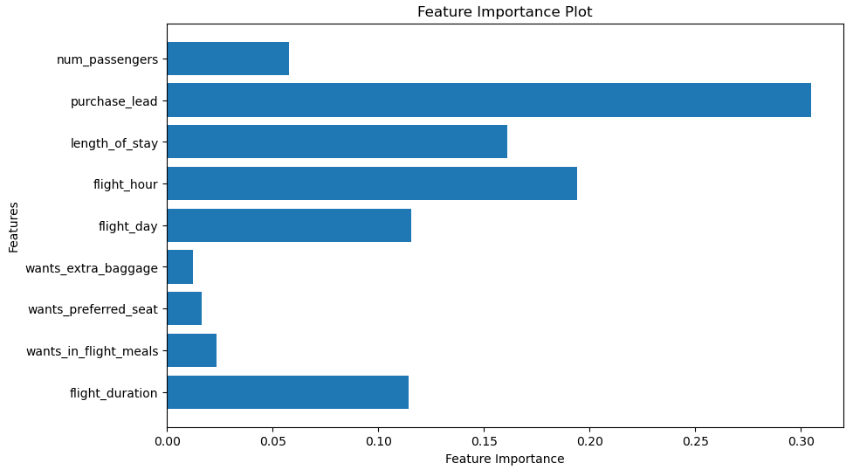
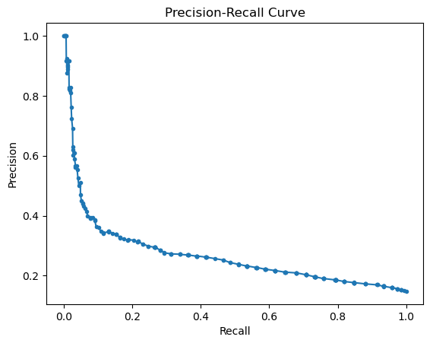
Understanding the influence of these features can guide marketing and service strategies.
Emphasizing promotions related to num_passengers and optimizing booking lead times could improve booking rates.
While flight timing (flight_day and flight_hour) is less influential, it should not be overlooked when considering customer preferences.
Accuracy : 0.8488

